Slide 1


Hack Born Team
1

Slide 2






The way we work
From People
Through Innovation
To Results
2
© 2017 Capgemini. All rights reserved.

Slide 3
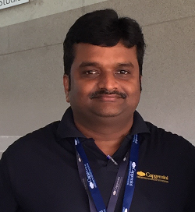
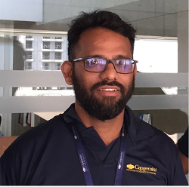
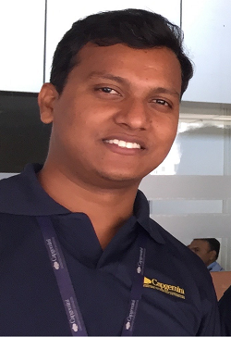
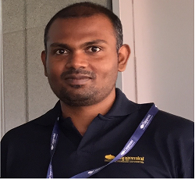
Our Team
Arun Ramamurthy
Shahul Shaik
Ashok Banoth
Binny Steevert
Technologies: iOS and Android
Technologies: Frontend, UI
Technologies: Oracle UCM, OWCS
Technologies: iOS and Android
3
© 2017 Capgemini. All rights reserved.

Slide 4
Use Case and Implementation
We believe that technology is made
by people, for people
4
© 2017 Capgemini. All rights reserved.

